Slide 1



SECOND ASSESSMENT
MEIC.A: User-Centered Design and Evaluation 2022/2023
The Imagine Designers
Team 22
Ana Catarina Teixeira 88064
Tomás Inácio 89841
Ana Carolina Baptista 95529
André Santos 86941
Yilin Wang 104808

Slide 2
5 keys components of user-centered design
RESEARCH
Personas
scenarios
IDEATING
PROTOTYPING
TESTING
Based on the research and the problem identified, ideate.
Possible solution.
Techniques to collect empirical data on how representative users perform realistic tasks with the product.

Slide 3
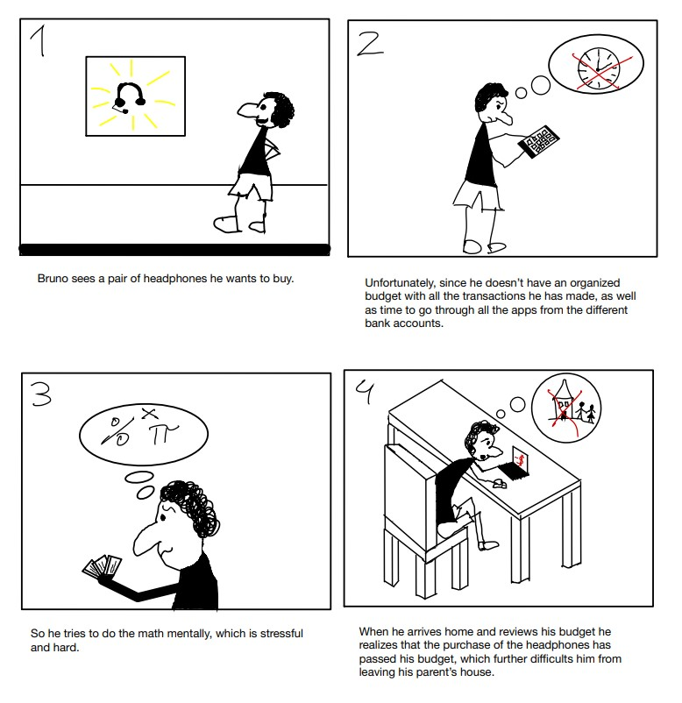
We do talk about bruno

Slide 4
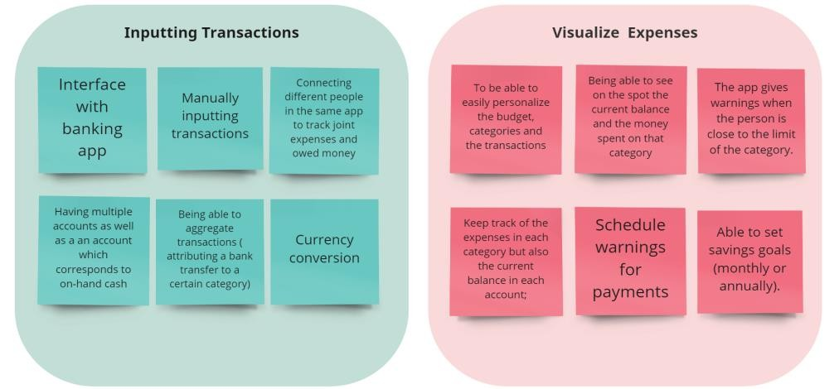
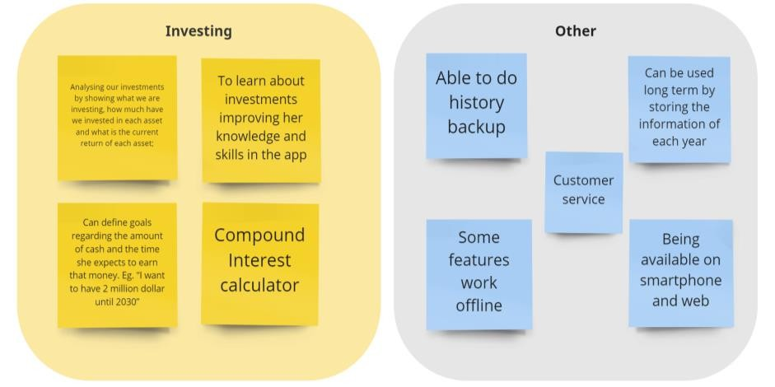
IDEATION

Slide 5
Low Fidelity Prototype
01.
The main purpose of low-fidelity prototypes is to test an idea and functionality and not the visual design. Also, the emphasis is not on details.

Slide 6
LOW FIDELITY PROTOTYPE
01.
Initial ideas
MOBILE APP
MANY FEATURES:
Interface with bank accounts
Split bills with friends
Schedule warnings for payments
Inputting transactions in personalized categories
Change transaction from one category to another
Able to add and remove categories
Manually add a new transaction

Slide 7

LOW FIDELITY PROTOTYPE
02.
Wizard of oz
testing
Feedback
Users interact with low fidelity prototype
Provide us with important information that will allow us to improve the prototype

Slide 8
LOW FIDELITY PROTOTYPE
03.
User's feedback

Slide 9
02.
MID Fidelity Prototype
A mid fidelity prototype is a prototype with limited functionality and design. However, it presents immense improvement if compared to the low fidelity prototype.

Slide 10
MID fidelity prototype
01.
Features

Slide 11
MID fidelity prototype
02.
More testing and feedback
Target: students over 18 and young working adults.
Team members paid attention to people's reactions and difficulties while testing.
Feedback obtained will be the basis of the high fidelity prototype implementations.

Slide 12
Future Perspectives
01.
User-friendly functional inclusive app
Decrease errors
Remote and face-to-face testing method
Volunteers must be varied and diverse, but still inside target groups previously chosen

